Slide 1
Git Going With GitHub
Daniel Ablog
November 20, 2014

Slide 2
Main Functions
Acts as an online cloud where project/code files can be stored and updated by multiple users
Similar to Perforce,
Allows updating code from local desktop clients
Can download “clones” or zip files of the repositories from the master repository

Slide 3
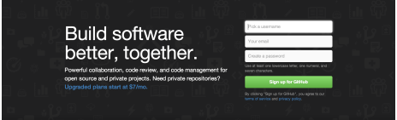
Creating An Account
Sign up online via GitHub website with username, password, and email
Free
Can start creating repositories and forking from other user repositories (e.g. ArudPilot repository)
Useful link: https://help.github.com/articles/set-up-git/

Slide 4
What is a Repository?
A place where all files can be stored online (e.g. files dealing with coding, pictures, CAD, text, word, etc.). Kind of like a cloud.
Forum for developer/author comments.
Can be public or private based on settings.
If public, others can view files and fork your repository to their account and also desktop.
Allows cloning and downloading from personal account
You can also download a GitHub portable program to use on your computer as a local GitHub . You must clone the repository in order to use the program from the local GitHub Desktop. This allows you to update files based on changes made by the repository owner/author. This is similar to creating a workspace in Perforce.
Can make pull requests when temporary changes have been made.
This basically asks for permission for your changes to be accepted into the main code and developers can discuss about the pending change.
Useful link: https://help.github.com/articles/create-a-repo/

Slide 5
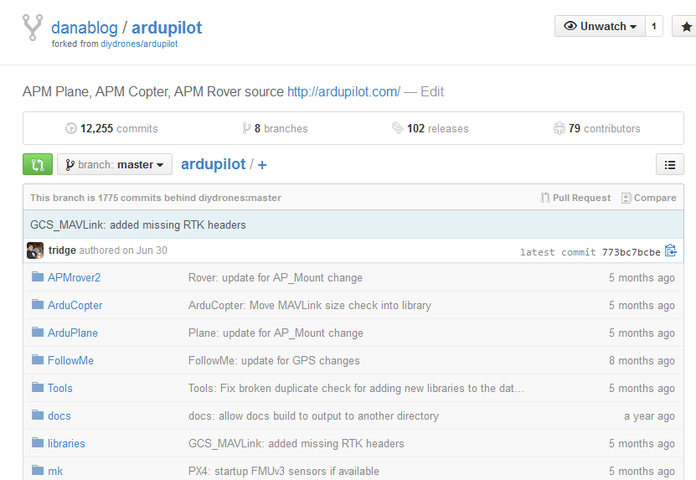
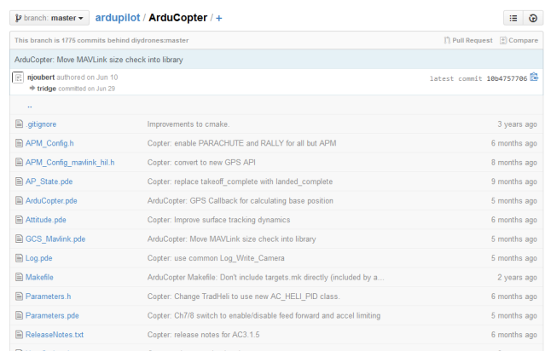
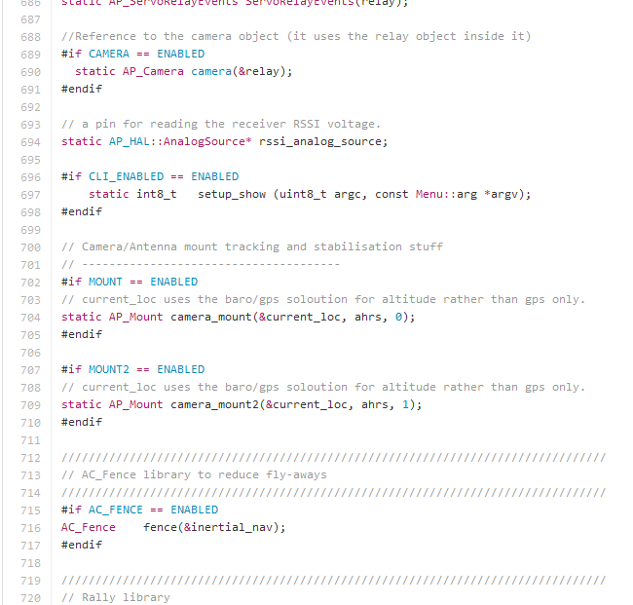
What is a Repository? (Cont.)
Contains projects and files associated
Can access all project files
Can view/alter code in online repository

Slide 6
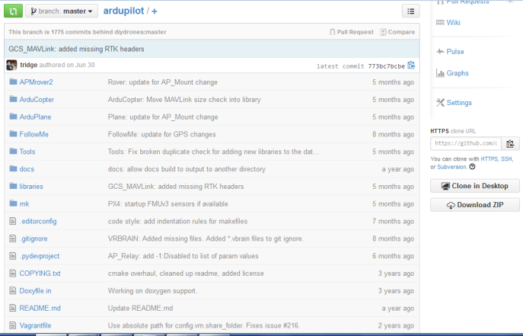
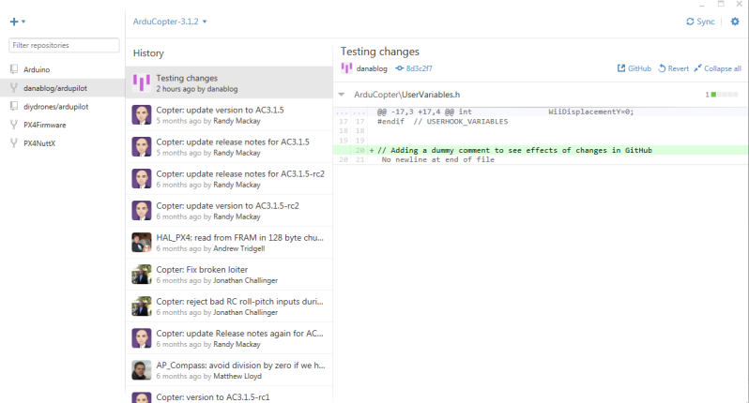
Copying a Repository
Online Repository
Set up account
Can either
“Fork” a branch of the master repository to personal account, or
Clone/download a copy of the repository directly to make changes to master repository
“Cloning” the repository to desktop “checks out” all the files in the repository
Allows you to make changes to that repository
Local GitHub Client

Slide 7

Copying a Repository (Cont.)
To fork a copy of the repository to your personal account
To clone or download zip

Slide 8
Making Changes
Once you have made an account and “forked” your desired repository, you can start editing files.
Can edit online or on desktop via GitHub Desktop.
When you make changes, GitHub previews the differences in files.
Then you can commit with an added description. (Sends changes to a local branch and not the master file. ).
If you want to make your change apply to the master branch, create a “pull request” on GitHub online to ask the main author for permission to make this change.
If accepted by the main author, the change will be made to the master branch.
Useful link: https://help.github.com/articles/editing-files-in-your-repository/
A more in depth instruction on how to change files is located in my user file under:
\UserFiles\danablog\GitHub\GitHub Presentation 14_11_20.pptx

Slide 9
GitHub vs. Perforce
GitHub | Perforce
Forking/cloning a repository | Adding a workspace on desktop
Commit changes | Mark for add
Pull Request | N/A
Sync files | Get latest revision
Revert | Revert/Revert if unchanged
Clone | Simultaneously checks out all files while making a desktop copy
Split | Diff Against

Slide 10
GitHub as a Replacement for Perforce?
Pros
Does not require a lot of space (Tbytes) as developers can have own copy of local repository.
Can work with files offline and save changes.
Open source. No licensing fees.
Cons
GitHub doesn’t have the easy visual GUI that Perforce has and the organization for adding/deleting files and tracking changes
GitHub doesn’t work well with large repository copies and binary files. Very slow.
GitHub is slow when syncing repositories because of overhead transfer of all files.
Conclusion
Works well with open source code (i.e. ArduPilot)
May not be a good replacement due to slow processing times for binary files

Slide 11
Sources
“GitHub Features”. Nov 20, 2014. GitHub Inc. 2014. https://github.com/features
“Version Control – Why Do Big Companies Use Perforce?”. Nov 20, 2014. Stack Exchange Inc. 2014. http://programmers.stackexchange.com/questions/85845/why-big-companies-use-perforce
Orsini, Lauren. “GitHub For Beginners: Don't Get Scared, Get Started”. Nov 20, 2014. Say Media Inc. 2014. http://readwrite.com/2013/09/30/understanding-github-a-journey-for-beginners-part-1

